Slide 1


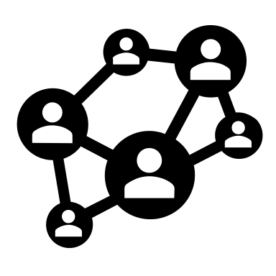
Problem
Algorithm/ Solution Design
High-level language Software
Application/ Program (high-level Language Program)
API
Software
Runtime Libraries
ABI
High-Level Language
Firmware; Microprogram (Assembly Language Program)
Kernel
VM, OS, MM, etc.
System Software
Compiler
Assembler / Linker
Drive
Machine Language Program
Software /Hardware Boundary
ISA
ISA, Instruction Set Architecture
CPU
Memory
I/O System
Interface
Bus
Bus
NIC
Microarchitecture
(Von Neumann Model)
Audio
Bus
Graphics
Computer Network
Datapath /Control
Register Transfer Notation, RTN
Hardware
PCI
Digital Design
Sequential Logic
Display /Graphics
Combinational Logic
Logic Gate, Electrons
Audio
Circuit Design
Mouse /Keyboard /VR /Controller
Memory

